Slide 1
Hydroponics Training
Sustainable Farming for the Future

Slide 2

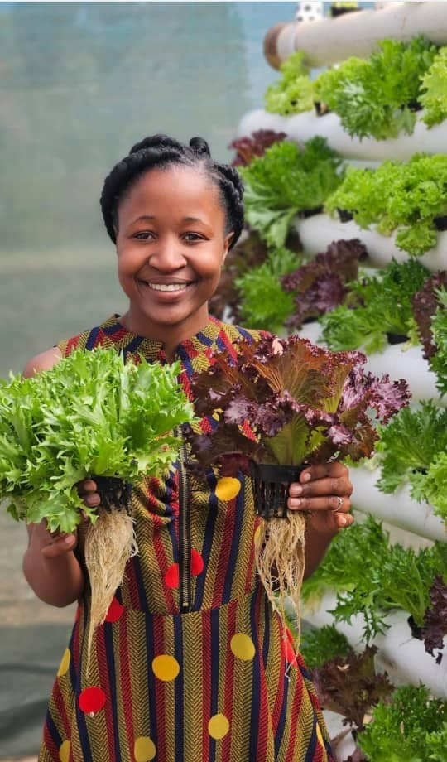
Ntombifikile Ncube
Multi-Award-Winning Agri-Entrepreneur | Hydroponics Expert | Climate-Smart Agriculture Trainer
Founder & CEO, Dexter Rising Spirit Technologies (Pvt) Ltd
Experienced hydroponics specialist & climate justice advocate
Trained hundreds in climate-smart agriculture, hydroponics, and agribusiness development
Empowers communities with innovative solutions for food security & economic growth
Education & Expertise:
  BSc (Hons) in Development Studies
  Certified in Hydroponics, Horticulture, Financial Literacy, Entrepreneurship & Green Livelihoods
Over 3 years of hydroponics farming experience

Slide 3

Background
Title: Hydroponics Training Program
Subtitle: Sustainable Farming for the Future
Presented by: Ntombifikile Ncube
Company: Dexter Rising Spirit Technologies

Slide 4
🌿 What is Hydroponics? 🌿
💧 Definition:
Hydroponics is a soilless farming method where plants grow in a 🌱 nutrient-rich water solution, absorbing essential minerals directly through their roots.
🎯 Origin of the Word:
The term "Hydroponics" comes from the Greek words:
🔹 "Hydro" (💦 water) + "Ponos" (⚙️ labor/work)
📜 First used in the 1930s by Dr. William Frederick Gericke, who pioneered 🌍 soilless plant cultivation!

Slide 5
Brief History of Hydroponics
📜 Ancient Beginnings – The Hanging Gardens of Babylon used soil-less growing techniques.
🔬 17th Century – Sir Francis Bacon's experiments proved plants could grow in nutrient-rich water.
🌱 18th-19th Centuries – German botanists developed nutrient solutions, advancing hydroponic research.
🌍 20th Century – Used during WWII to grow food in harsh conditions; NASA explored hydroponics for space missions.
🏢 Commercial Growth – Expanded in urban farming, greenhouses, and vertical farms.
🚀 Modern Advancements – Automation, LED lighting & improved nutrient solutions enhance efficiency.
🌎 Future Potential – A key solution for food security, water conservation & sustainable agriculture.

Slide 6
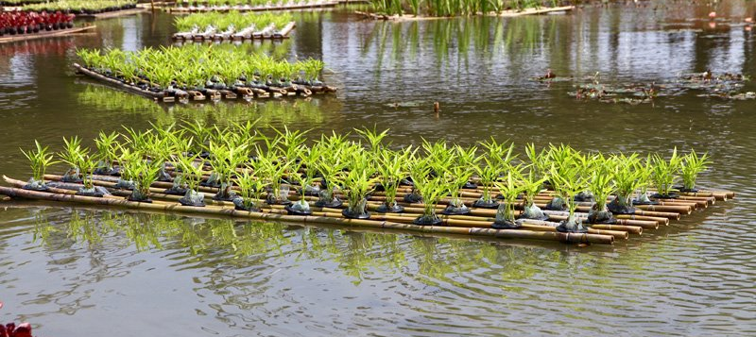
Ancient garden
Example of a floating garden

Slide 7
Introduction to Hydroponics
🌱 What is Hydroponics?
Hydroponics is a method of growing plants without soil, using a nutrient-rich water solution to deliver essential minerals directly to plant roots.
🌍 Why Hydroponics?
🌱 Water Efficiency – Uses up to 90% less water through recirculation.
🌾 Higher Yields – Faster growth with direct nutrient access.
🏙 Space-Saving – Ideal for urban & vertical farming.
🌡 Controlled Environment – Optimized temperature, humidity & lighting.
📅 Year-Round Production – Independent of seasons & weather.
🌍 Eco-Friendly – Less pesticide use, minimal runoff, & lower carbon footprint.
💧 Nutrient Efficiency – Precise delivery, reduced waste, & recyclable solutions.
⚡ Faster Harvests – Shorter growth cycles & higher productivity.

Slide 8
continuation…
🌍 Global Challenges in Agriculture
Food Security: Rising population and decreasing arable land threaten food production.
Climate Change: Unpredictable weather, droughts, and extreme temperatures affect farming.
Water Scarcity: Agriculture consumes 70% of global freshwater; water shortages are increasing.
🚀 Future of Farming
With climate change & food security challenges, hydroponics is a sustainable solution for modern agriculture.

Slide 9
The Science Behind Hydroponics
Soilless Growth & Photosynthesis: In hydroponics, plants grow without soil, but they still perform photosynthesis. They absorb water and nutrients through their roots (from the nutrient solution) and carbon dioxide (CO₂) from the air. This supports their growth just like plants grown in soil.
Protosynthesis Carbon dioxide (CO₂) + Water (H₂O)→light Glucose (C₆H₁₂O₆) + Oxygen (O₂)
pH & EC (Electrical Conductivity): Proper pH (5.5–6.5) and EC levels ensure plants can absorb the nutrients needed for photosynthesis.
Oxygenated Water: Oxygen in the water helps the roots respire, supporting nutrient uptake and sustaining the process of photosynthesis.

Slide 10
Key Components of Hydroponics
Water Reservoir: Holds the nutrient solution for plant growth.
Nutrient Solution: A mix of water and nutrients absorbed by the plants.
Growing Medium: Supports the plant roots (e.g., coco coir, perlite).pH & EC
Meters: Measure and monitor the pH and nutrient strength.
Light Source: Provides energy for photosynthesis (e.g., grow lights).
Water Pump & Tubing: Circulates the nutrient solution to plant roots.
Aeration System: Oxygenates the water to support root health.Plant Support: Keeps plants upright (e.g., net pots, supports).

Slide 11
Types of Hydroponic Systems
Deep Water Culture (DWC): Plants float in nutrient-rich water.
Nutrient Film Technique (NFT): Shallow channels with a continuous flow of nutrients.
Dutch Bucket System: Ideal for larger plants, like tomatoes.
Aeroponics: Roots suspended in air, misted with nutrient solution.
Trough System: Shallow, long containers for growing crops.

Slide 12
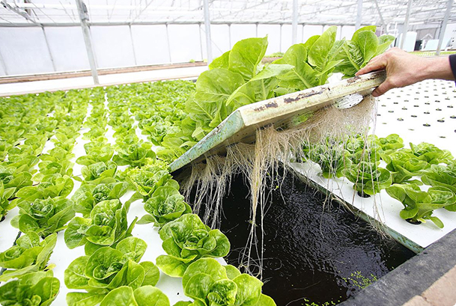
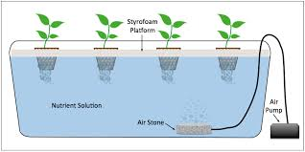
Deep Water Culture

Slide 13
Deep Water Culture (DWC)
System Description
Plants: Float in nutrient-rich water with their roots submerged, absorbing nutrients directly.
Best For: Leafy greens like lettuce, herbs, and small vegetables.
Pros
Fast plant growth: Roots have constant access to water and nutrients.
Simple design: Easy to set up with basic components.
Water efficiency: Less water used compared to traditional farming.
Cons
Risk of root diseases: Without proper oxygenation, roots can rot.
Space limitations: Not ideal for large plants.
Temperature sensitivity: Water temperature must be monitored to prevent plant stress.

Slide 14
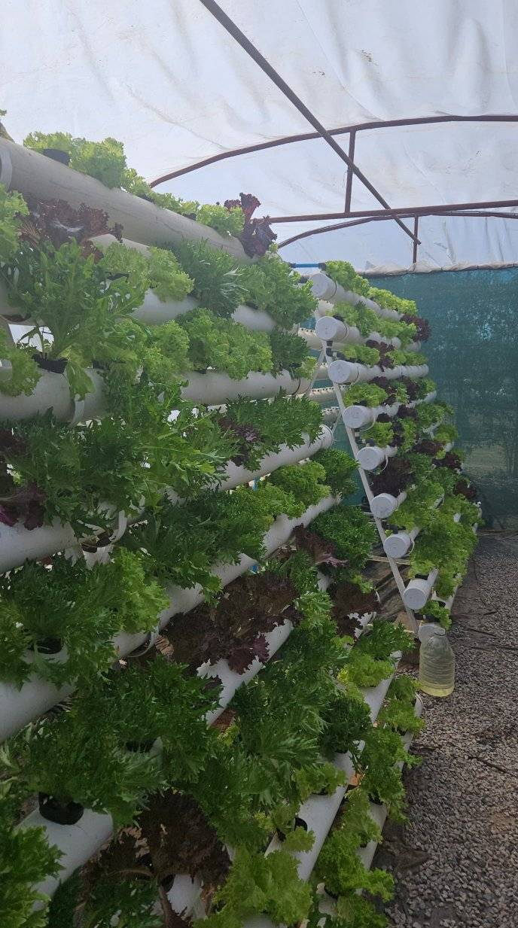
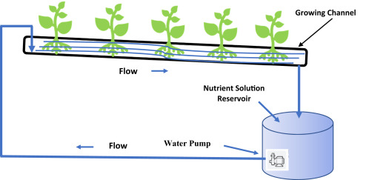
Nutrient Film Technique (NFT)

Slide 15
Nutrient Film Technique (NFT)
System Description
Plants: Grow in shallow channels with a continuous flow of nutrient solution that flows over their roots.
Best For: Herbs, small leafy greens, and strawberries.
Pros: ✅
Efficient Water Use: Constant nutrient flow reduces water waste.
Lightweight Setup: Can be placed in small areas or vertical systems.
Minimal Growing Medium: Less mess compared to soil.
Cons: ❌
Root Clogging: Roots may clog the channels if not maintained properly.
Requires Constant Monitoring: Nutrient solution needs to be replenished and balanced often.
Limited Plant Size: Best for smaller plants; may not support larger crops like tomatoes.

Slide 16
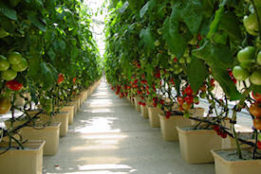
DUTCH BUCKET SYSTEM

Slide 17
Dutch Bucket System
System Description
Plants: Grown in individual buckets filled with a growing medium and fed by a nutrient solution.
Best For: Larger plants like tomatoes, peppers, and cucumbers.
Pros: ✅
Suitable for Large Plants: Supports heavier, larger crops.
Great for Tomatoes: Provides sufficient space for root growth and nutrient absorption.
Easy to Scale: Can be expanded by adding more buckets.
Cons: ❌
Watering Can Be Inconsistent: If not properly monitored, some plants may receive more water than others.
Requires More Space: Needs larger space for individual buckets.
Complex Setup: Requires more components (buckets, tubing, pumps) and space for installation.

Slide 18
Aeroponics

Slide 19
Aeroponics

Slide 20
Aeroponics
System Description
Plants: Roots are suspended in air and misted with a nutrient solution.
Best For: Fast-growing plants, leafy greens, herbs, and high-value crops.
Pros: ✅
Rapid Plant Growth: High oxygen levels lead to faster growth rates.
Minimal Water Usage: Uses mist, reducing overall water consumption.
No Soil-Borne Diseases: Since there's no soil, pests and diseases are minimized.
Cons: ❌
High Maintenance: Requires precise control of misting and humidity.
Sensitive to Failures: If misting fails, roots can dry out and die quickly.
Costly Setup: Initial investment in aeroponic systems can be expensive.

Slide 21
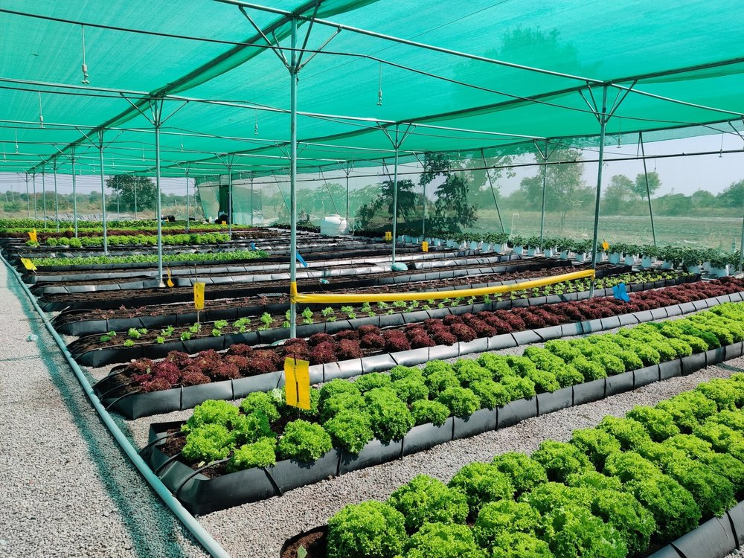
Trough System

Slide 22
Trough System
System Description
Plants: Grow in long, shallow containers filled with a growing medium, typically used in commercial setups for leafy greens.
Best For: Lettuce, herbs, and other small to medium-sized crops.
Pros: ✅
Efficient Space Use: Can grow multiple plants in a compact area.
Easy Maintenance: Simple system to set up and manage.
Versatile: Can grow a variety of crops in the same system.
Cons: ❌
Water Wastage: If not properly managed, water can overflow or stagnate.
Limited Mobility: Once set up, the system is not easy to move.
Root Competition: Plants may compete for nutrients and space

Slide 23
Macronutrients (Needed in Large Quantities)
NUTRIENT SOLUTION
Water uptake: disease resistance, and fruit quality.
  Deficiency: Yellowing/browning of leaf edges, poor fruit development.
Calcium (Ca): Strengthens cell walls, prevents disorders like blossom end rot.
  Deficiency: Distorted growth, stunted roots.
Nitrogen (N): Supports chlorophyll production, photosynthesis, and protein synthesis.
  Deficiency: Yellowing leaves, stunted growth.
Phosphorus (P): Promotes root development, flowering, and energy transfer.
  Deficiency: Dark green or purple leaves, delayed maturity.

Slide 24
Macronutrients (Needed in Large Quantities)
5. Potassium (K):
• Potassium regulates water uptake, osmotic balance, and enzyme activation within plant cells.
• It enhances resistance to disease and stress, improves fruit quality, and promotes overall plant vigor.
• Deficiency symptoms include leaf scorching, yellowing or browning of leaf margins, and poor fruit development.
6. Magnesium (Mg): Key component of chlorophyll, essential for photosynthesis.
  Deficiency: Yellowing between leaf veins, curling leaves.
8. Sulfur (S): Supports protein formation and chlorophyll synthesis.
  Deficiency: Yellowing of young leaves, stunted growth.

Slide 25
Micronutrients (Needed in Small Quantities)
Iron (Fe): Supports chlorophyll synthesis and electron transport.
  Deficiency: Yellowing of young leaves, weak growth.
Manganese (Mn): Enzyme activation and nitrogen metabolism.
  Deficiency: Leaf spots, poor root development.
Zinc (Zn): Essential for enzyme function and hormone regulation.
  Deficiency: Stunted growth, small leaves.
Copper (Cu): Supports enzyme activation and chlorophyll production.
  Deficiency: Wilting, leaf curling.
Boron (B): Important for cell division and flower development.
  Deficiency: Cracked stems, poor fruit set.
Molybdenum (Mo): Assists in nitrogen assimilation.
  Deficiency: Pale leaves, weak plants.
Chlorine (Cl): Helps with photosynthesis and disease resistance.
  Deficiency: Wilting, leaf mottling.

Slide 26
Mixing Nutrient Solutions Accurately
Use Quality Ingredients – Choose water-soluble hydroponic fertilizers free from contaminants.
🔹 Correct Ratios – Follow manufacturer guidelines for macronutrient & micronutrient concentrations.
🔹 Water Quality – Use clean, filtered water; test for pH (5.5–6.5), EC, and impurities.
🔹 Mixing Sequence – Add nutrients one at a time, starting with macronutrients, stirring well.
🔹 Dissolution & Temperature – Ensure complete dissolution at 18–24°C (65–75°F).
🔹 Monitor & Adjust – Regularly check pH, EC, and nutrient balance; store in airtight, labeled containers.

Slide 27
Hydroponic System | Best For | Advantages | Challenges | Suitability in Zimbabwe
Dutch Bucket System | Tomatoes, peppers, cucumbers | Supports large plants, scalable, good for commercial use | Needs space, complex setup | ✅✅✅ Highly suitable for greenhouse farming & commercial growers
Nutrient Film Technique (NFT) | Herbs, lettuce, strawberries | Water-efficient, good for small spaces, scalable | Needs constant monitoring, prone to root clogging | ✅✅ Good for urban & small-scale commercial farming
Deep Water Culture (DWC) | Lettuce, herbs, leafy greens | Simple setup, low maintenance, high oxygen supply | Requires aeration, not ideal for large plants | ✅✅ Best for beginners & small-scale hydroponics
Aeroponics | High-value crops, fast-growing plants | Rapid growth, minimal water use, no soil-borne diseases | High maintenance, expensive setup | ✅ Best for research, specialized high-tech farming
Trough System | Lettuce, herbs, spinach | Easy to set up, efficient use of space, versatile | Water wastage risk, root competition | ✅✅✅ Best for commercial-scale leafy greens production

Slide 28
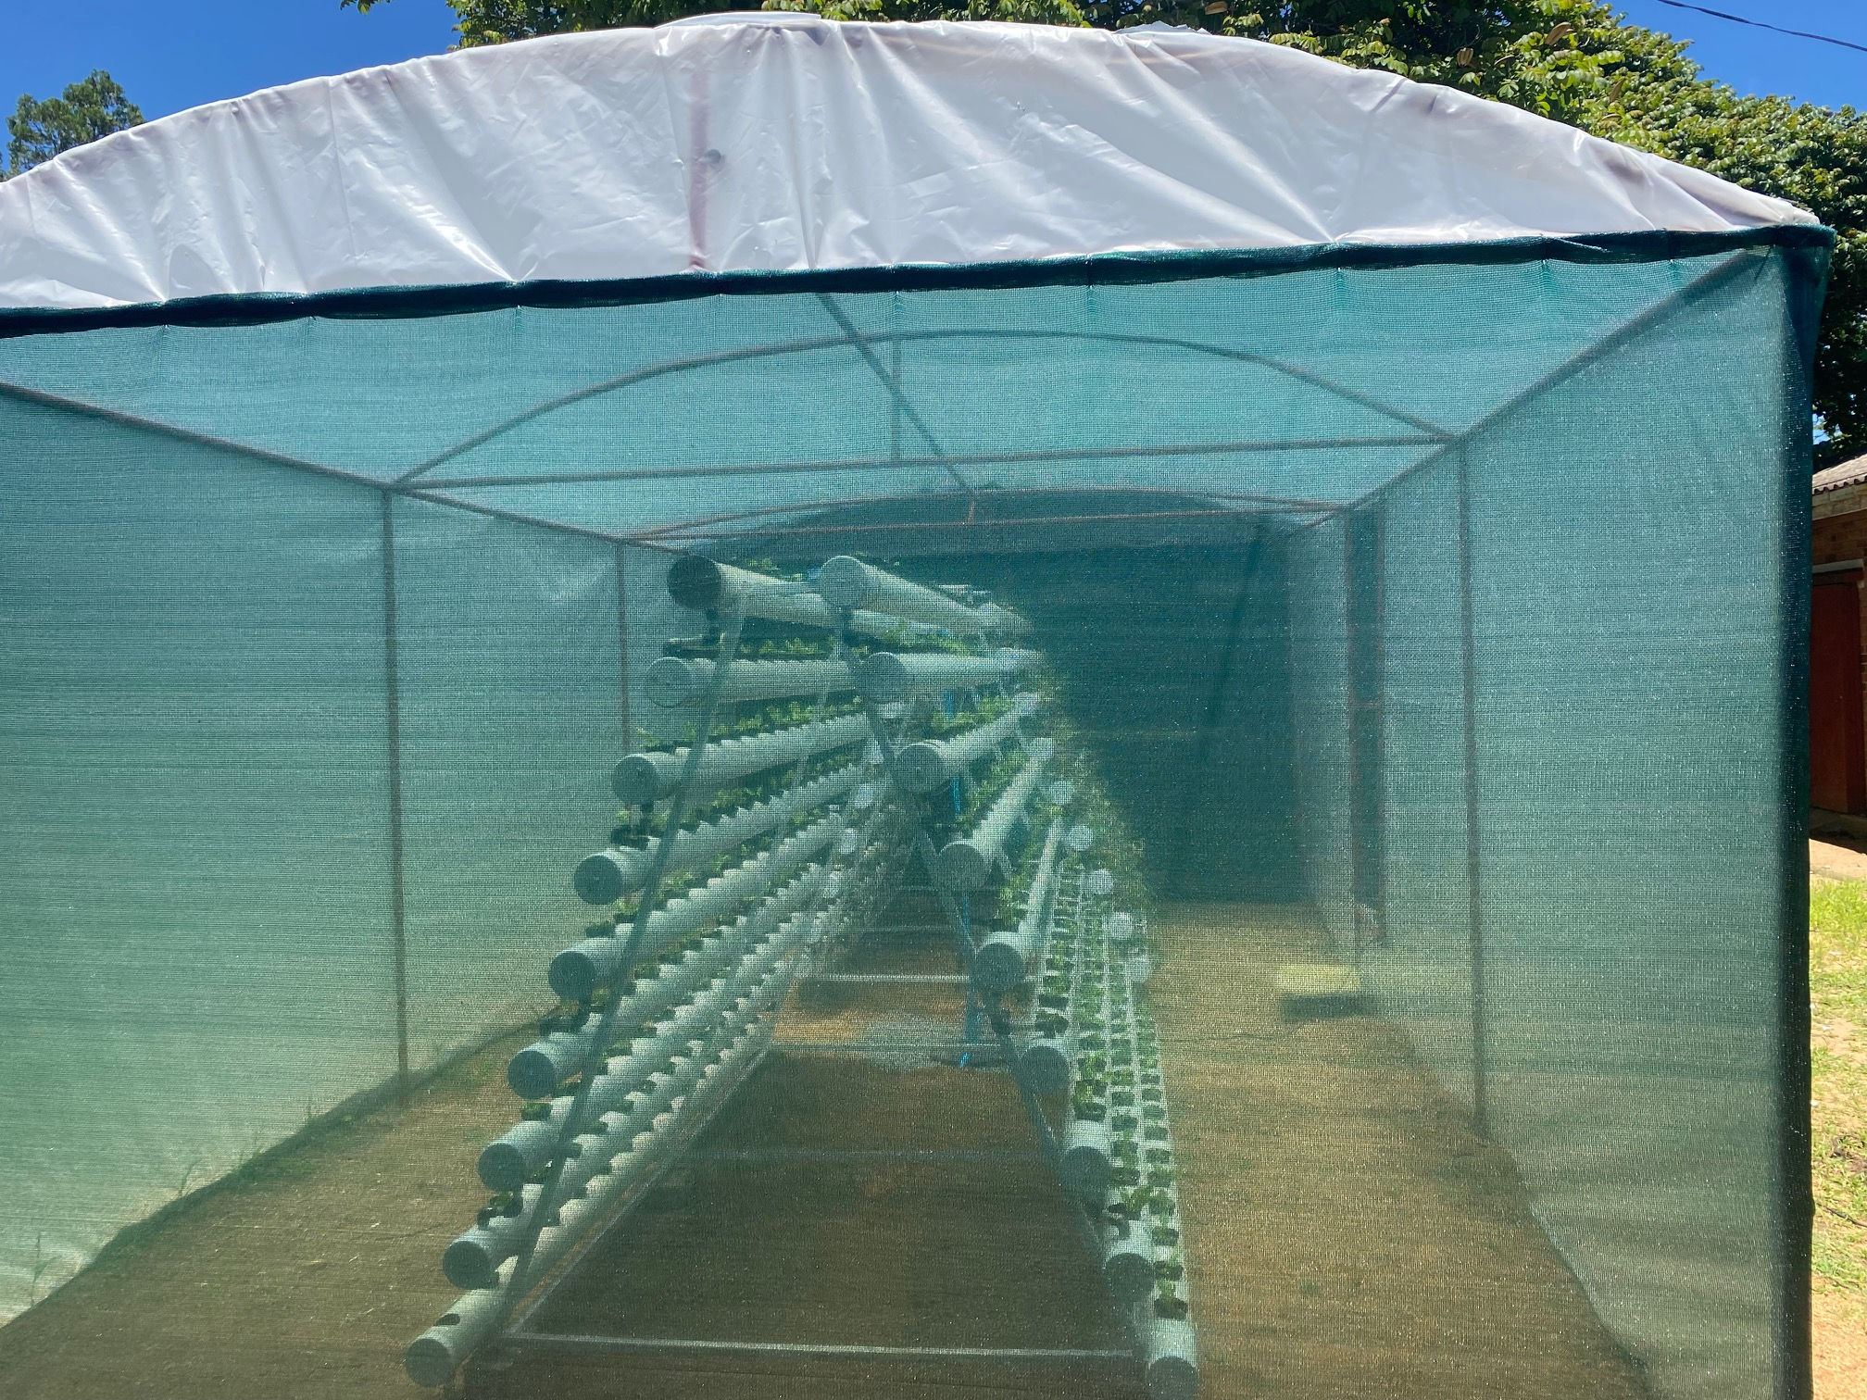
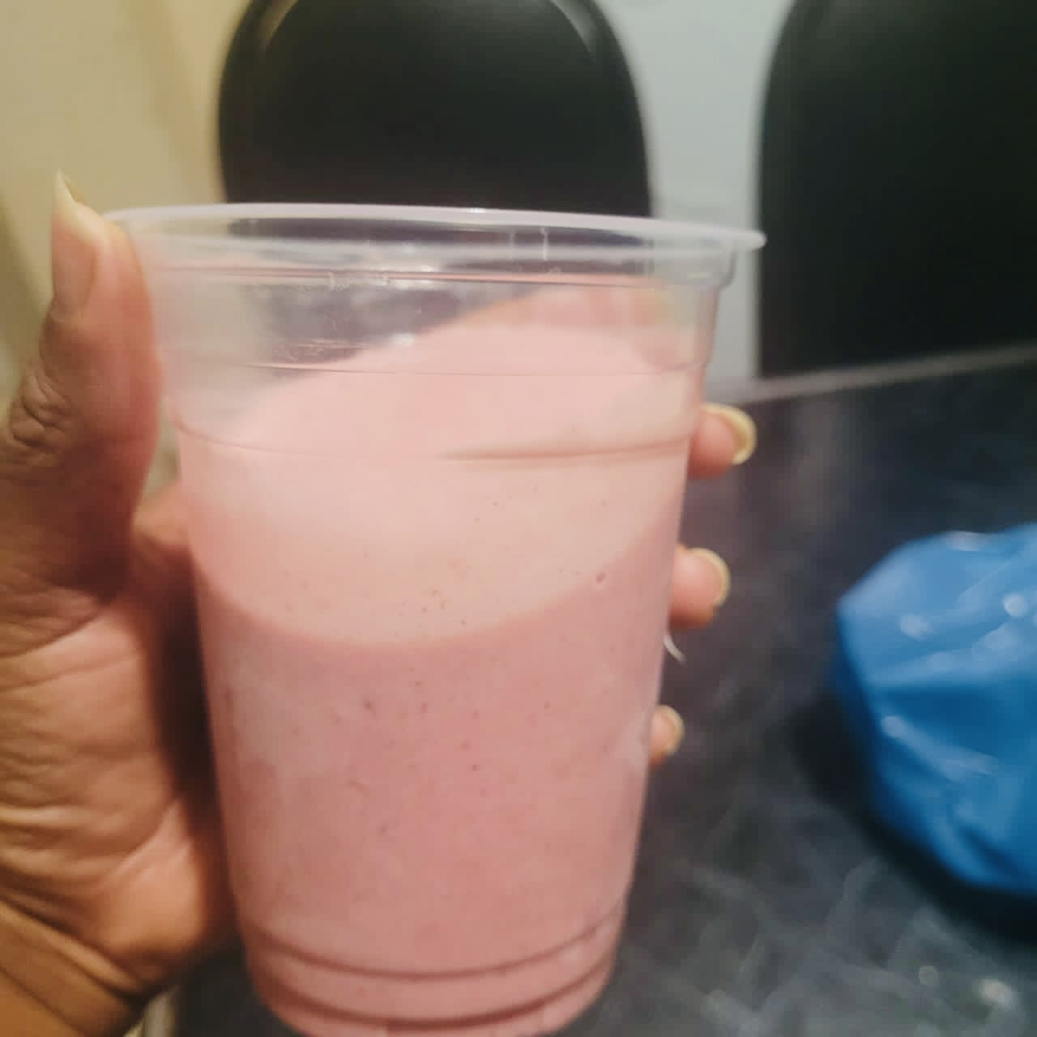
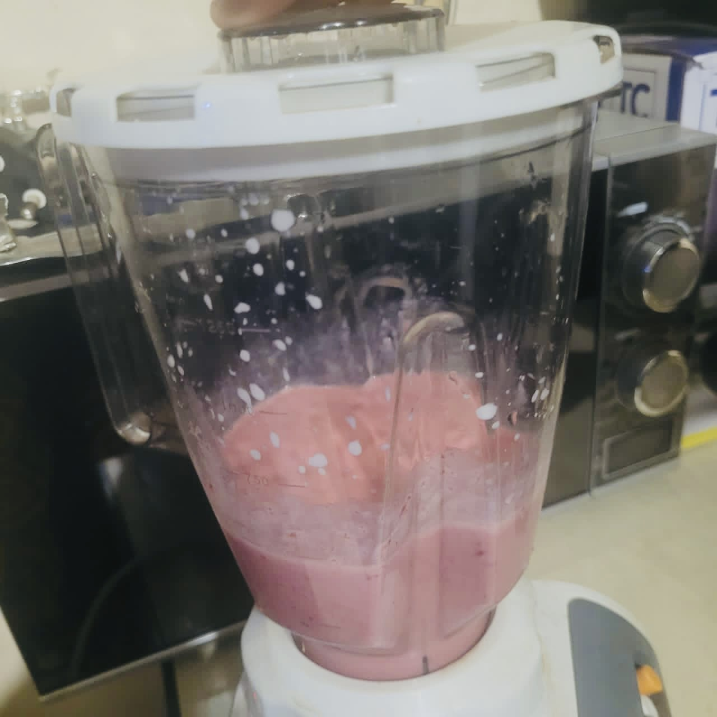
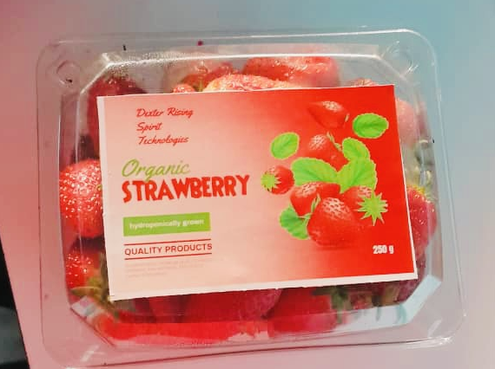

Slide 29
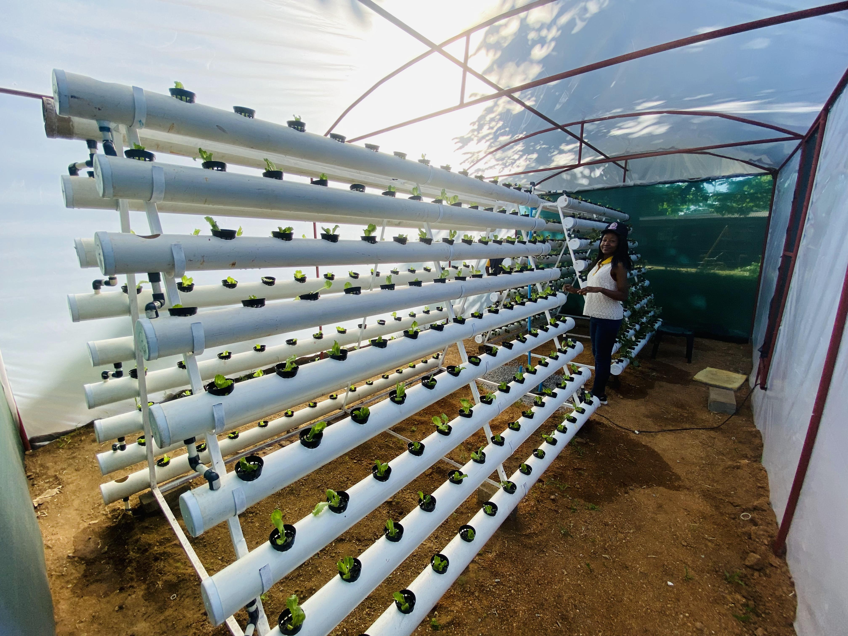

Slide 31
