Slide 1
Solid Waste Management
Solid Waste Management-The complete process of collecting ,treating and disposal of solid wastes or The practice of collecting ,transporting, processing or disposing of ,managing and monitoring various waste materials.
Sustainable Waste Management-An approach that focuses on the reduction of waste generation, promoting the three Rs,and reducing the resulting environmental impacts of waste disposal(It addresses the Triple Planetary Crisis, a global crisis that encompasses climate change effects, biodiversity loss and pollution)

Slide 2
Cont..
It involves a combination of practises that promote a circular economy where resources are used efficiently. Products are re-used and waste that ends up at dumpsites of landfills is minimized
(New business models for waste management and the circular economy offer economic opportunities and can make considerable contribution to climate protection)

Slide 3
Cont…
Unavoidable waste needs to be recycled and fed back into the circular economy

Slide 4
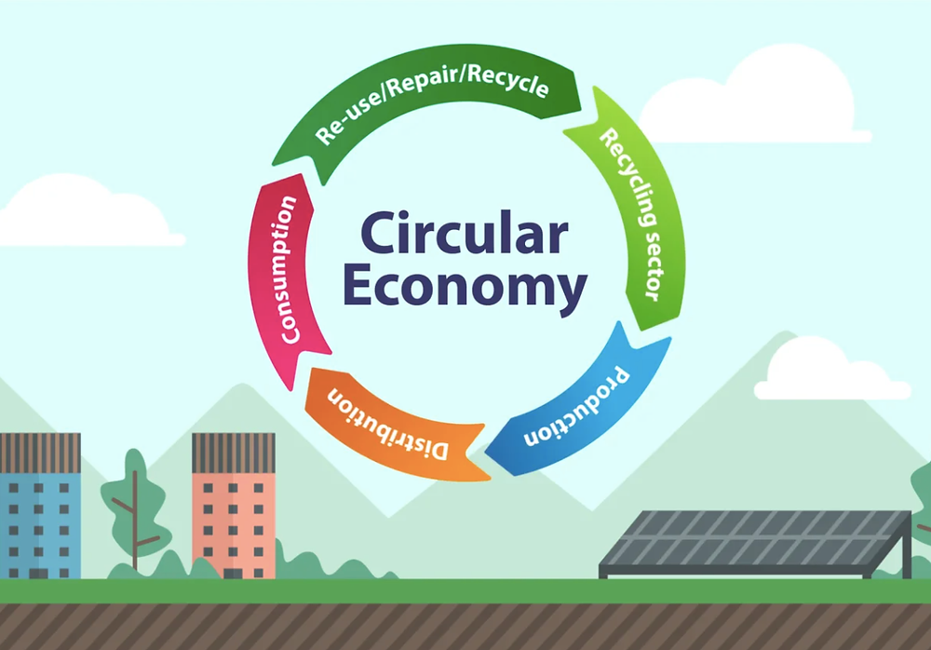

Slide 5
Circular Economy
Resources are conserved and waste minimized , through strategies like recycling, reusing , repurposing and refurbishment(Avoiding the linear model and using the circular model)
This is a system designed to be regenerative and sustainable, prioritising the long-term well being of our planet

Slide 6
Advantages
Cost Savings
Increase the life span of the landfills
Aims for Zero Waste
Lower Carbon Emissions
The circular economy offers environmental sustainability, resource efficiency and job creation

Slide 7
Legislation Governing Solid Waste Management
Environmental Management Act(CAP 20:27)
Gives EMA mandate to regulate transportation and disposal of any type of solid waste
SI 6 of 2007 (Effluent and Solid Waste Disposal)
Provides for licensing for solid waste disposal and waste management enterprises including recyclers of plastic waste
SI 98 of 2010(Plastic Packaging and Plastic Bottles)
Ban on commercial distribution of thin plastic less than 30 micrometres
Ban on importation, commercial distribution and use of polystyrene/Styrofoam for food packaging
The Urban Councils Act (CAP 29:15)
Gives Local Authorities governing urban areas responsibly to provide refuse collection and disposal services within their areas of jurisdiction
Supporting documents (Integrated Solid Waste Management Plan 2014-2020),Solid Waste Survey in Bulawayo)

Slide 8
Opportunities for Youths in Solid Waste Management
Waste sorting at source(Colour coded bins, solid waste sorting cages(Recycling Projects) and waste kiosks
Products can be made from plastics, artefacts, bags, different designs from bottles, brooms (wezesha),cobra and amabhodo, Growing Seedlings in dishes and ,shake shake containers ,Exhibitions: International shows eg Trade Fairs ,Sanganai Hlanganani Expos
Incorporating solid waste management at different functions (Youth Functions) collect recyclable waste for uptake by recycling companies
Partnerships in the existing projects implemented(value addition, upscaling etc.)
Partnering in Research with different institutions (In solving solid waste challenges)

